Slide 1

CoERS @ IIT Madras NAVISTA
Dr. Venkatesh Balasubramanian
Professor, RBG Labs, Dept of Engineering Design, IIT Madras
Head, Centre of Excellence for Road Safety (CoERS)
Member, Expert Advisory Group, MoRTH
Advisor, Govt of RJ, JH, HR, TN

Slide 2
WHY THIS PROJECT?

Slide 3
STATS
Global Impact
A study of 973 overtaking accidents in England found young drivers often make poor decisions, older drivers are prone to right-turn accidents, and common issues include head-on collisions and loss of control, highlighting the need for better understanding of overtaking maneuvers.
https://www.sciencedirect.com/science/article/abs/pii/S000145759700105X
Regional Data: India
In India, overtaking maneuvers resulted in 7.3% of all road accidents and 7.8% of total fatalities (MORTH 2016).
https://www.researchgate.net/figure/Overtaking-accidents-at-different-road-elements_fig2_304529903
National Crime Records Bureau (NCRB) data for 2021, nearly 90% of road accident deaths were due to speeding, overtaking, and dangerous driving combined
https://www.drishtiias.com/daily-updates/daily-news-analysis/road-accidents-in-india-4
National Crime Records Bureau : The NCRB states that 41.1% of total road accidents in India were caused by rash driving and negligence in 2022. Overtaking on blind curves or in no-overtaking zones would likely fall under this category.
https://ncrb.gov.in/

Slide 4
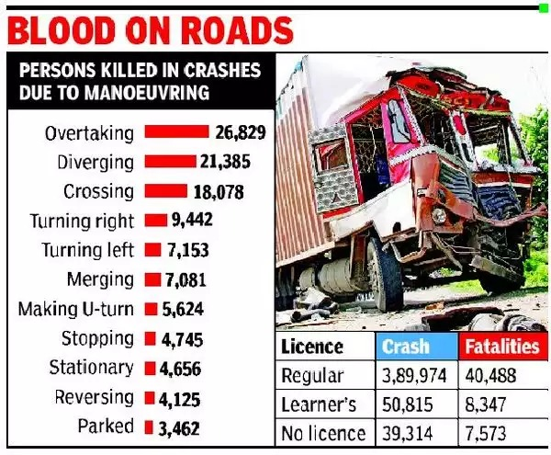

Slide 5
OBJECTIVE

Slide 6
PRIME OBJECTIVE
To develop and implement a Vehicle-to-Vehicle (V2V) communication system that enhances road safety by preventing dangerous overtaking maneuvers. This system will provide real-time alerts to drivers about the presence and intentions of nearby vehicles, reducing the risk of collisions and improving overall traffic flow on highways.

Slide 7
SPECIFIC OBJECTIVE
System Initialization and Configuration
Objective: Ensure the microcontroller and communication modules are correctly initialized and configured for optimal performance. Functional Component: Microcontroller, GPS module (NEO-6M), LoRa module (SX1272).
GPS Signal Acquisition and Data Parsing
Objective: Accurately acquire and parse GPS data to determine the vehicle's current location and speed. Functional Component: GPS module (NEO-6M), Microcontroller.
Vehicle Position and Speed Calculation
Objective: Calculate precise vehicle position and speed in real-time to provide accurate data for communication. Functional Component: Microcontroller, GPS data.4.
V2V Communication Establishment
Objective: Establish a reliable communication link between vehicles using the LoRa module to transmit and receive data. Functional Component: LoRa module (SX1272), Microcontroller.
Overtaking Intention Detection and Signal Transmission
Objective:Detect overtaking intentions and transmit this information to nearby vehicles to alert them of potential hazards. Functional Component: Microcontroller, GPS data, LoRa module (SX1272).
Signal Reception and Processing by
Nearby Vehicles
Objective: Ensure nearby vehicles can receive and process overtaking signals to determine the position and speed of the overtaking vehicle. Functional Component: LoRa module (SX1272), Microcontroller.
Continuous Monitoring and Data Logging
Objective: Continuously monitor the system's performance and log relevant data for analysis and future improvements. Functional Component: Microcontroller, Data storage (e.g., SD card module).
Driver Alert Generation
Objective: Generate audio and visual alerts to inform drivers of the presence and intentions of nearby vehicles, especially during overtaking. Functional Component: Audio/Visual alert systems (e.g., buzzers, LEDs, dashboard notifications).

Slide 8
WHERE WILL THE WORK BE DONE?

Slide 9
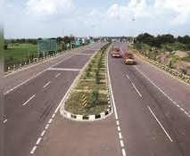

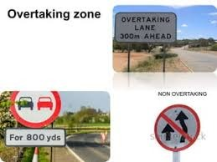
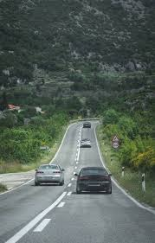
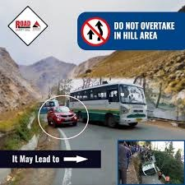
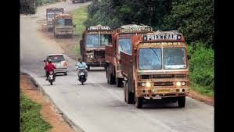
HIGHWAYS AND FREEWAYS
MAJOR ARTERIAL ROADS
( VITAL DURING PEAK HOURS)
INDUSTRIAL ZONE
HILLY REGIONS
MOUTAINOUS REGION
INTERCITY ACCIDENT PRONE ZONES

Slide 10
HOW WILL YOU DO? BILL OF MATERIALS TOOLS REQUIRED METHODOLOGY

Slide 11
REQUIREMENTS
BILL OF MATERIALS
Components | Quantity | Price
Arduino UNO | 2 | 760
GPS Ublox Neo 6M | 2 | 760
SX 1276 Semtech LoRA Module | 2 | 1080
Antenna{RF} | 2 | 472
9V Battery | 2 | 50
LM 7805 Voltage Regulator | 2 | 20
 | TOTAL | 3142
SOFTWARE
Integrated Development Environment (IDE) for microcontroller programming (e.g., Arduino IDE, STM32CubeIDE)
GPS parsing libraries
LoRa communication libraries
Simulation tools (e.g., MATLAB, Simulink)

Slide 12
METHODOLOGY

Slide 13
1.System Initialization and Module Configuration
6.Signal reception & Data Processing by Nearby vehicles
7.Driver Alert Generation
2.GPS Signal Acquisition &Data Processing
5.Overtaking Detection & Signal sending
8.Feedback Approach sending &Reception (if Anamoly)
3.Vehicle Position &Speed calculation
4.V2V Communication Establishment via LoRa
9.Continuous system monitoring & Data logging

Slide 14

Thank You !!!

